Slide 1
Remaining Useful Life Estimation Using Temporal Convolutional Network Fusion
Second KIM presentation
Zvonimir Dujmić
Department of Computer Science,
Vrije Universiteit Amsterdam,
Amsterdam, Netherlands

Slide 2
Agenda
Introduction to predictive maintenance
Dataset
Methods
Experiments and results
Conclusion
Questions

Slide 3
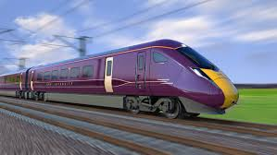

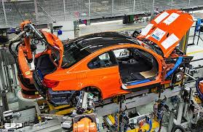
Introduction to predictive maintenance
Notes:
Every day we rely on variety of machines but the truth is the machines breakdown unless it's been maintained.

Slide 4
Introduction to predictive maintenance
Reactive maintenance
Preventive maintenance
Predictive maintenance
Notes:
Companies followed different maintenance program to increase operational reliability and reduce costs.

Slide 5
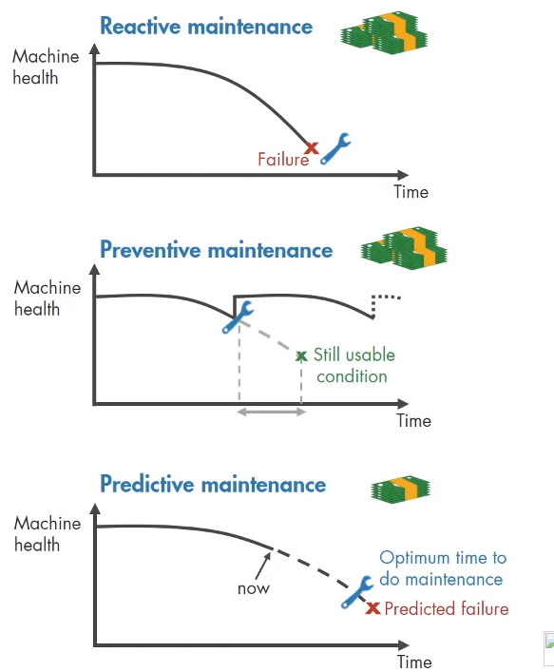

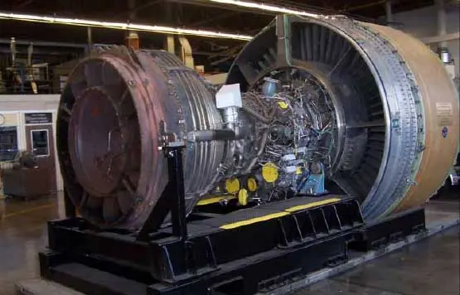
Notes:
One way is to do reactive maintenance, where the machine is used to its limits and repair only after machine failure. If you're dealing for example with a light bulb then it may make sense to go with the reactive approach. But think of the complex system with some very expensive parts you can't really risk running it failure as it will be extremely cost to repair highly damaged parts. But, more important, it's a safety issue.

Slide 6
Notes:
That's why many organizations try to prevent failure before it occurs by performing regular checks on their equipment. One big challenge with preventive maintenance is determining when to do it. Since you don't know when failure occur you have to be conservative in your planning especially if you're dealing with safety critical equipment. But by scheduling maintenance very early you are wasting machine life that is still usable and this adds to your costs.

Slide 7
Notes:
However if you can predict when machine failure will occur you can schedule maintenance right before it will start. The good news is that predicted maintenance let's you estimate time to failure. It also pinpoints problem in your complex machinery and helps you identify which parts needs to be fixed. This way, you can minimize downtime and maximize equipment lifetime.

Slide 8
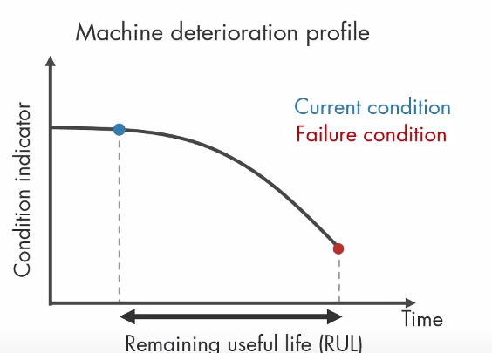
Remaining Useful Life
Notes:
The way to estimate it is to predict remaining useful life. The remaining useful life is computed as a time between some point in time and the failure of machine. Depending on the system the time period can be represented in terms of number of days, hours, circles, meters or any other quantity. Basically what we are trying to do is predict how much time is left till machine breaks down.

Slide 9
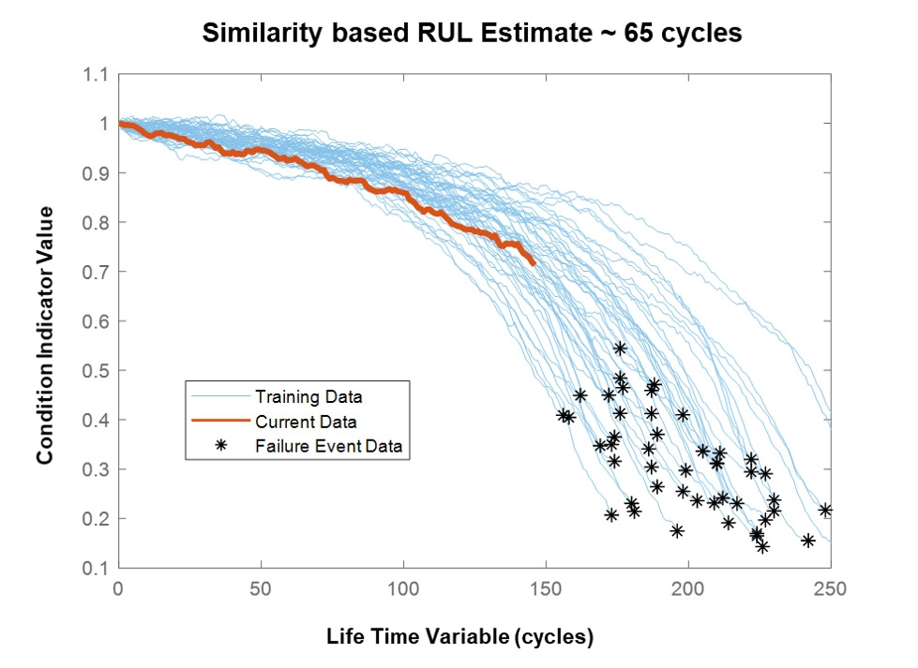
Remaining Useful Life
Notes:
So how we do it? We collect data from machinery sensory data and we collected in same intervals until machine breaks now. Then, we use machine learning algorithms to identify the patterns in breakdowns and estimate remaining useful life.

Slide 10
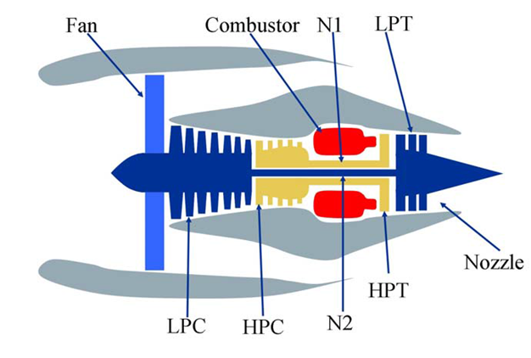
Dataset
C-MAPSS
NASA - Prognostic and Health Management Challenge
Simulated dataset
Turbofan engines
Sensory data
Notes:
In this thesis, we have used C-MAPSS dataset, created by NASA for the Prognostic and Health Management Challenge PHM08. The data set is build using C-MAPASS, an advanced simulation environment with many setups. That simulation is considered to be one of the better simulations for the turbofan engines. The data set is publicly available on the NASA website, and it's widely used for remaining useful life testing. The data consists of time-series measurements of various sensor Like temperature, pressure, fan speed, Burner fuel-air ratio etc.

Slide 11
C-MAPSS
Sub-dataset: | FD001 | FD002 | FD003 | FD004
Engines in the training set | 100 | 260 | 100 | 249
Engines in test set | 100 | 259 | 100 | 248
Max/min cycles for training | 362/128 | 378/128 | 525/145 | 543/128
Max/min cycles for test | 303/31 | 367/21 | 475/38 | 486/19
Operating conditions | 1 | 6 | 1 | 6
Fault modes | 1 | 1 | 2 | 2
TW length | 30 | 21 | 36 | 18
Training samples | 17731 | 48558 | 21120 | 56815
Test samples | 100 | 259 | 100 | 248
Notes:
The data set is divided into four subsets. Each subset consists of measurements taken from many engines of the same type. For this thesis, we have only used one subset FD001. The first one and the 3rd one are pretty similar, but the second 4 have smaller differences. Overall by reading the literature, the first one is most representative to use. In subset that we use is 100 different engines.

Slide 12
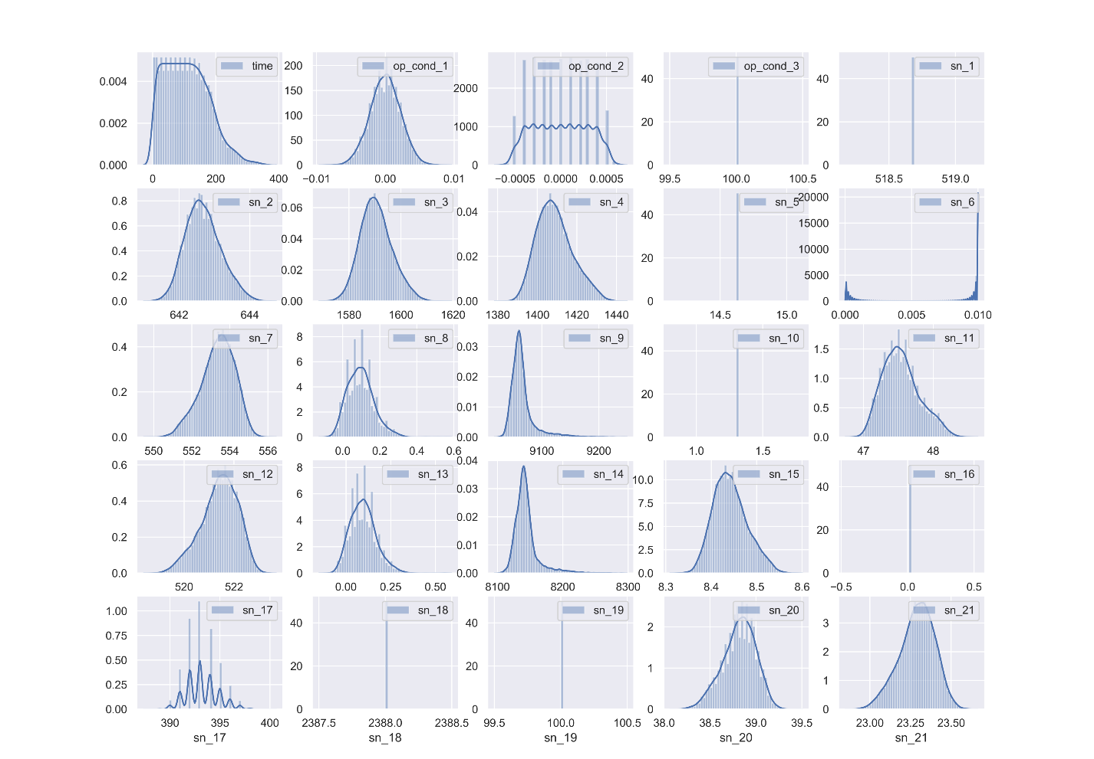
Data distribution
Notes:
As the data inside consists of sensory values, for example, a temperature that can vary from zero to 100 or even more, and some pressure values that are around 1000 etc. Also, because we use Neural networks, we have decided to normalize the values between zero and one using Minmax Scaling. This image shows the distribution of sensory values. From it, we can see that most of the values are from a skewed gaussian distribution.

Slide 13
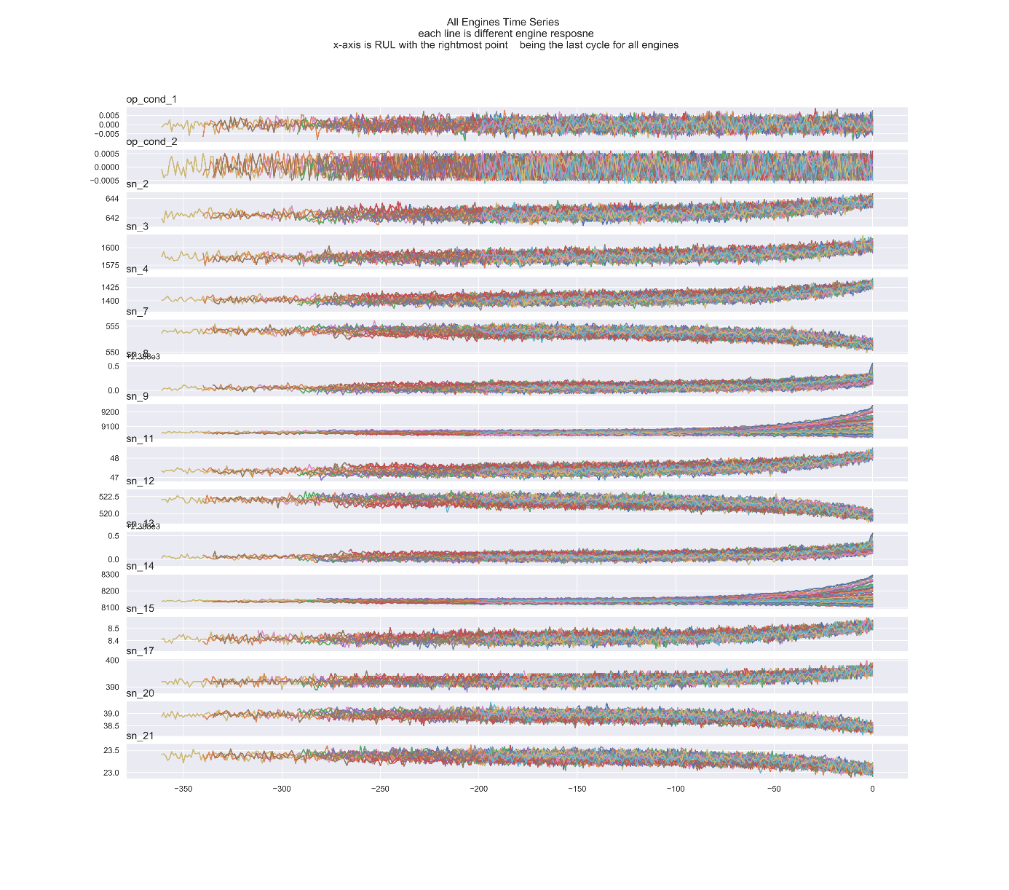
C-MAPSS sensory values
Notes:
The more important graph is this one it represents sensor values over cycles. Also we can see how the data is flat at the beginning an curves at the end meaning that data drastically changes when the failure is near. So the main problem with this dataset is that sensor values are constant for the most of the time and then exponentially change when failure is going to happen. I want to mention that they don't start at the same time period but they finish at the same time. Also because in data set we don't have the same number of time steps per engine we need to select proper window size to best fit our data.

Slide 14
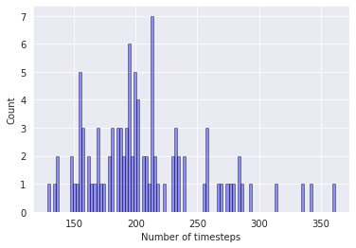
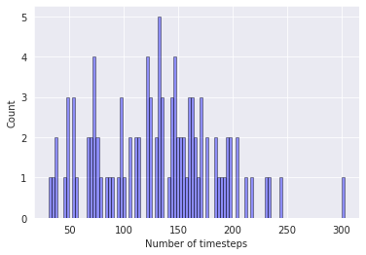
C-MAPSS Number of Timesteps
Traning set
Test set
Notes:
This graph shows distribution of time steps in training (left) and test set (right). from it we can see variation in training and test set the training has most around 200 and that said has the most around 150. because of that we cannot select windows size above 200 because we will not be able to test on anything.

Slide 15
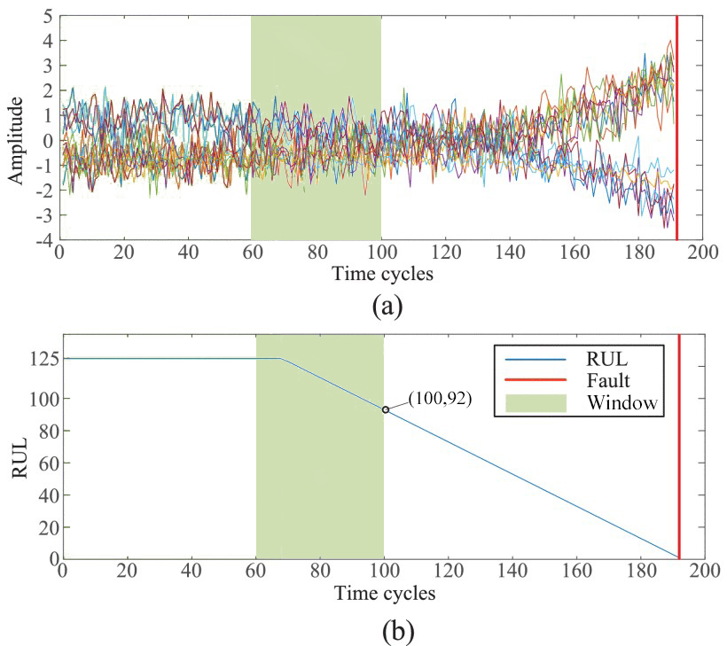
Block of data with RUL
Linear RUL
Piecewise RUL
Notes:
One thing I didn't mention is how the remaining useful life is calculated because it doesn't come with the dataset. We take a window size, for the last timestep in it, we count how many cycles it is till failure and set that number. By that RUL is the decreased linearly. That is not the same as the sensory values. For that reason, the implementation of a piecewise function improves the result. What it does it's flattens remaining useful life until it achieves a certain point in our case 125, which means that all RULs above 125 are set to 125. After that point, RUL is decreased linearly. In this image, we can see how window processing is working. We have 40 cycles of window size that goes from 60 cycles till cycle 100 and for it estimated RUL has to be 92. To train our models, we make this kind of pairs of window sizes with sensory data and RUL that has to be predicted.

Slide 16

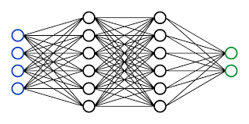
Methods
Neural networks
Long short-term memory
Temporal Convolutional Network
Autoencoder
Fusion
Notes:
The methods that we use in this thesis are mostly based on neural networks. those are long short term memories LSTM, temporal commercial network TCN, autoencoders and and Fusion.

Slide 17
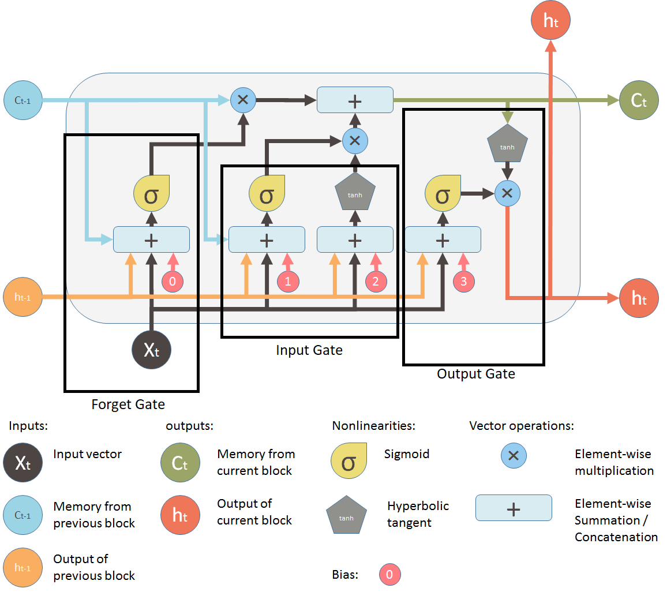
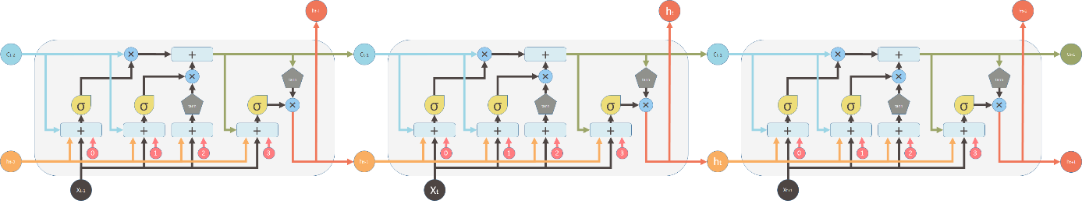
Long short-term memory (LSTM)
Notes:
Long short-term memory is an artificial recurrent neural network architecture used in the field of deep learning. Unlike standard feedforward neural networks, LSTM has feedback connections. It can not only process single data points, but also entire sequences of data. A common LSTM unit is composed of a cell, an input gate, an output gate and a forget gate. The cell remembers values over arbitrary time intervals and the three gates regulate the flow of information into and out of the cell.

Slide 18
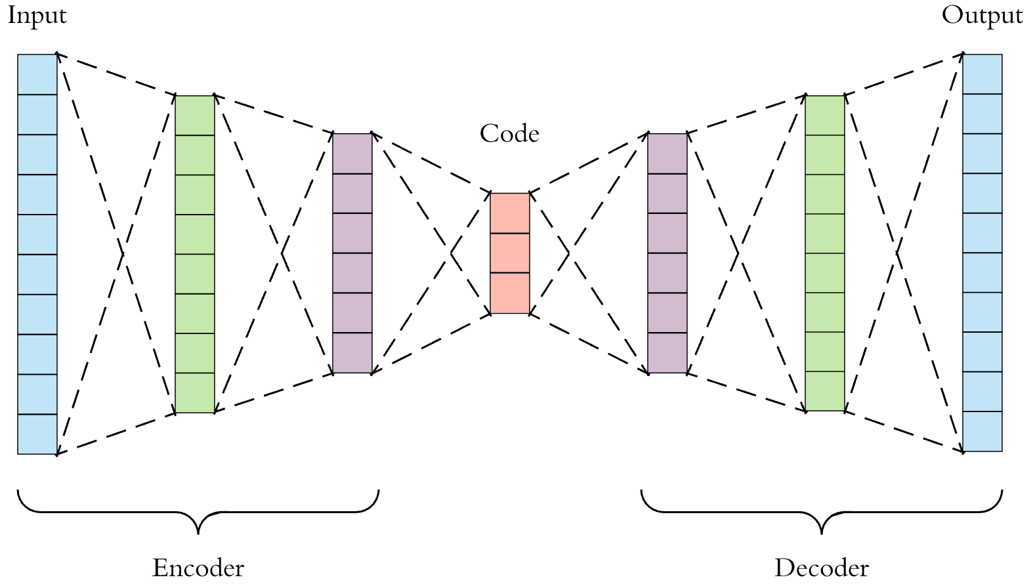
Autoencder
Encoder-Decoder
Dimensionality reduction
Smoothing data
Notes:
Autoencoders are a form of compression. They are composed of two parts encoder and decoder. Usually, we build them from fully connected layers, but that does not have to be a case, we can also use TCN or LSTM or any other network type. We train them in a way that the input and the output are the same data. Basically the autoencoder has to learn how to replicate data. Because the size of the layers are decreasing till the middle and then increasing again if you strip first half of the autoencoder, the encoder part, we can use it as dimensionality reduction. Or if we keep it full we can use it as nose reduction toll.

Slide 19
Temporal convolutional network (TCN)
Deepmind WaveNet
Dilated Convolutions
Residual Blocks
Advantages
Parallelism
Flexible receptive field size
Low memory requirement
Notes:
The idea for using temporal convolution networks comes from deep mines paper WaveNet. They have used TCN in speech generation. The animation shows how a TCN is structured. It is a fully convolutional neural network, where the convolutional layers have various dilation factors that allow its receptive field to grow exponentially with depth. Also it consist of residual block. It stacks two dilated causal convolution layers together, and the results from the final convolution are added back to the inputs to obtain the outputs of the block.
The advantages are
Parallelism: convolutions can be done in parallel since the same filter is used in each layer.
Flexible receptive field size: A TCN can change its receptive field size in multiple ways. stacking more dilated (causal) convolutional layers, using larger dilation factors, or increasing the filter size
Low memory requirement for training:
Capturing local information: Using convolution operation helps in capturing local information along with temporal information

Slide 20
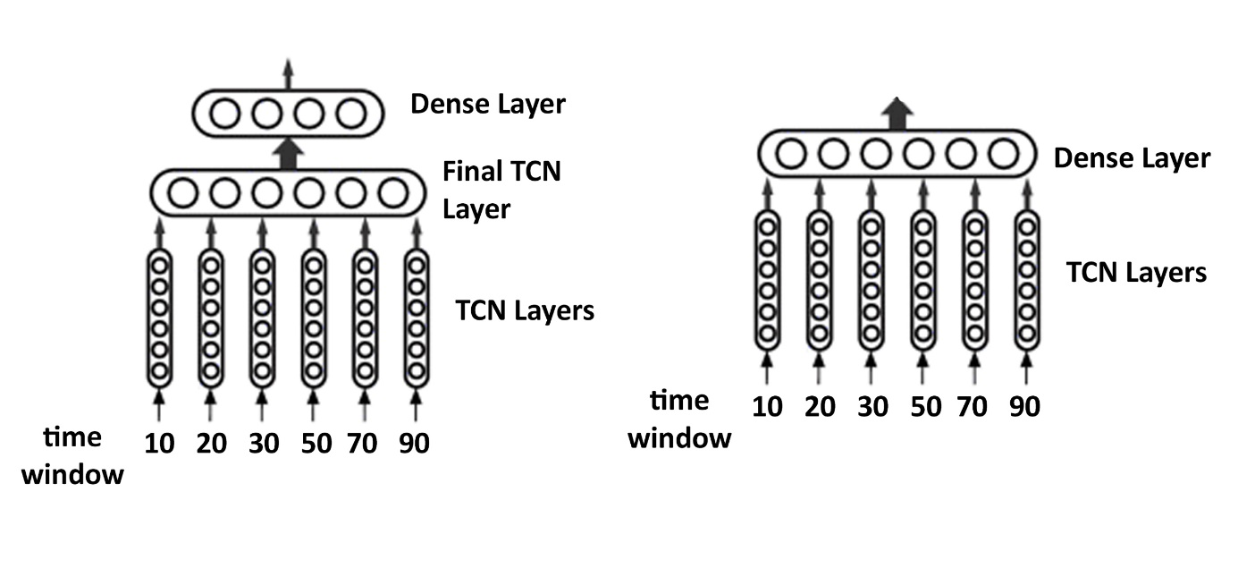
Fusion
Combine multiple model outputs into one and make it as input to the final model.
Notes:
This technique is used by Zhang et al. and got excellent results in RUL estimation. For that reason, we have tried to implement it in our work only difference is that they used LSTM, in our work use TCN. How it works is simple, it takes the output of multiple TCN and then combines it as an input of the final model. We have tested two different versions, one where we use once more use TCN as a final layer and then to the fully connected neural network and one without final TCN.

Slide 21
Experiments and Results
Noise reduction autoencoder
TCN and Autoencoder
LSTM and autoencoder
Piecewise and TCN Fusion
Parameter tuning:
Window size
Number of layers
Kernel size
TCN Fusion
Notes:
Here are the experiments that we conduct during this thesis. Autoencoder for noise reduction, Autoencoder combined with TCN and LSTM. Furthermore, we have tested how piecewise function affects results. Then we have experimented with parameter tuning on temporal convolutional network and finally our best experiment with TCN and fusion

Slide 22
Noise reduction Autoencoder
Fully connected neural network.
Tested different number of layers.
starts with 32, decreases by double.
Number of layers | R2 distance score
1 | 0,6148
2 | 0,8628
3 | 0,9762
4 | 0,9776
5 | 0,9745
Notes:
First we have tested autoencoder on task of noise reduction. The idea behind that was that sensory data was full of noise and using out encoder could reduce it and by that helped improve results. We have tested different numbers of layers. By this result 4 layers achieves sufficient score and increasing layers does not improve results.

Slide 23
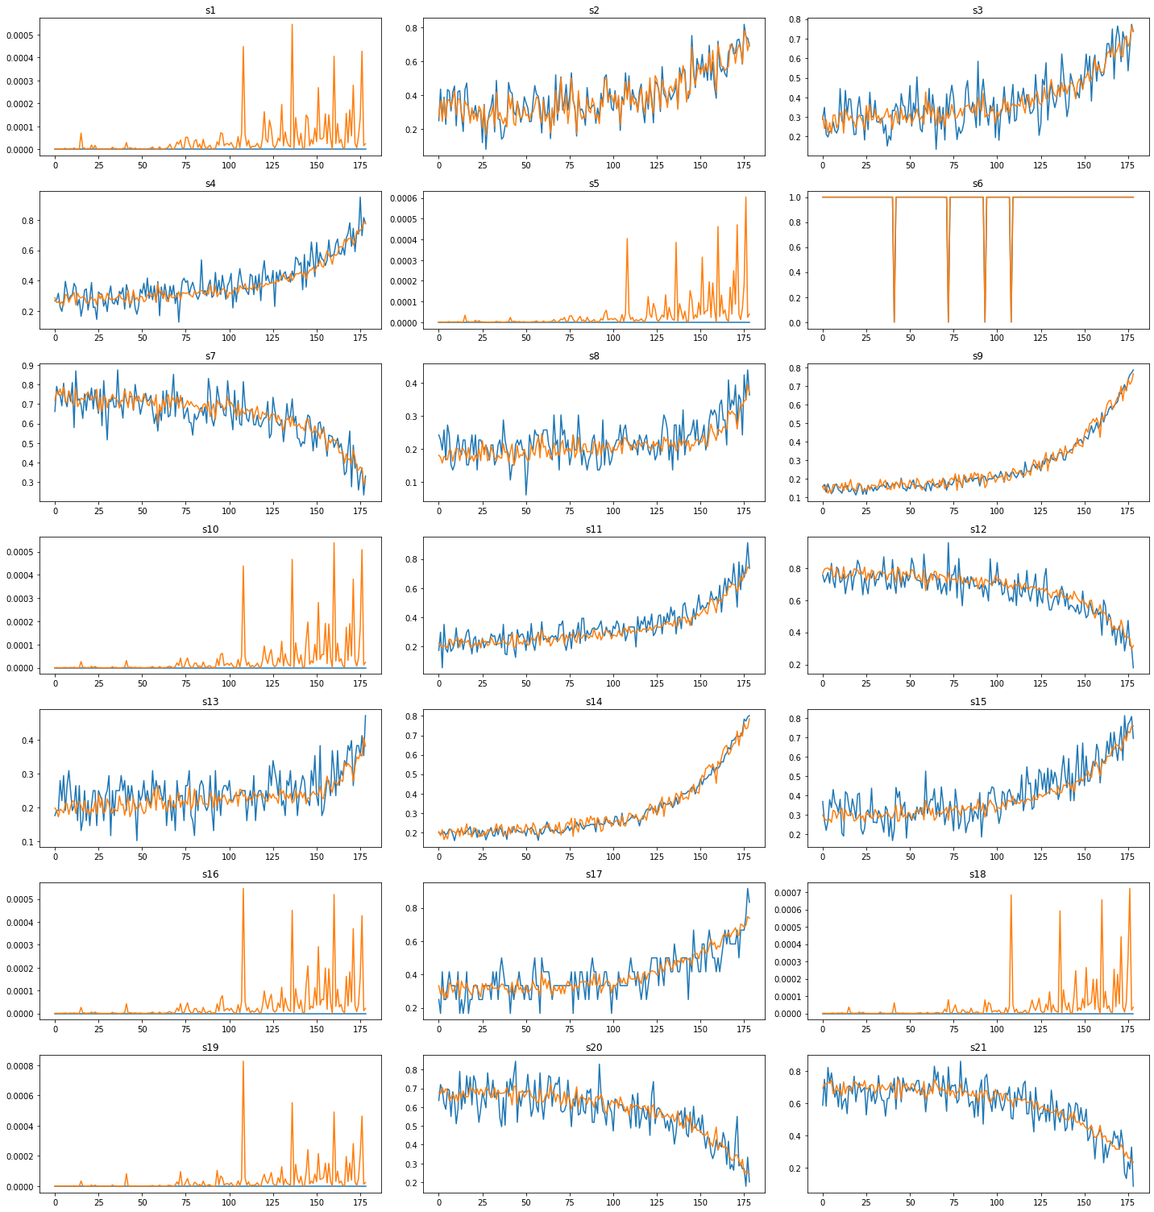
Notes:
How results look like we can see on this image, the orange is smooth data the blue is original. The data is significantly smoother, except for the sensor values that don't change over time (1,5,6,10...), there the autoencoder only makes it worse.

Slide 24
TCN and Autoencoder
TCN with two layers.
First layer of TCN with 12 filters and dilations (1,2,4,8,16,32).
Dropout of 20%
Second layer has 6 filters, and dilations (1,2,4,8,16,32)
Dropout of 20%
Dense layer
Tested:
different output sizes of encoder part
autoencoder for a noise reduction.
Notes:
For this experiment, we have used TCN with two layers. The first layer of TCN with 12 filters and dilations (1,2,4,8,16,32), after which dropout of 20% is applied, the second layer has 6 filters, same dilations and dropout as the previous layer, and at the end one dense layer with a linear activation function. For autoencoder, we have used previously mentioned noise reduction autoencoder form whom we have striped decoder part and only used encoder. We have also tested different output sizes of encoder part, as well as using full autoencoder for a noise reduction.

Slide 25
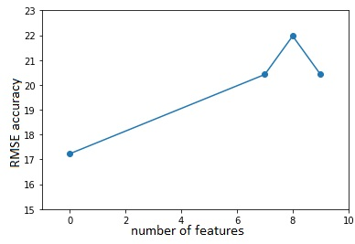
TCN and Autoencoder
Notes:
The best results were given by using autoencoder for noise reduction that is represented as 0. Trying to use autoencoder for dimensionality reduction didn't improve results. Furthermore, these results achieved by using AE for noise reduction are much worse than just using TCN alone. We could conclude that TCNs are resistant to sensory noise that is in the dataset. Probably the reason for that is that TCN has enough robustness to cope with a problem of noise in a data

Slide 26
LSTM and Autoencoder
Model | RMSE Score
LSTM | 17.59
AE Smooth | 19.16.
AE 21to9 | 18.75
AE 14to9 | 19.60
AE 14 smooth | 18.41
LSTM with two layers.
First 100 units.
Second 50 units
20% dropout after each.
Tested:
LSTM and noise reduction of 21 and 14 sensors
Autoencoder from 21 to 9 features
Autoencoder from 14 to 9 features
Notes:
For this, we use two-layer LSTM, first with 100 units and second with 50 units. After each dropout of 20% is applied, the final layer is a dense layer. AE Smooth represents an experiment where have we used autoencoder to smooth all 21 signals in propose of noise reduction. AE 21to9 stands for autoencoder that makes dimensionality reduction from 21 sensory data to 9. AE 14to9 is for LSTM whose input is encoded data of 14 selected sensors reduced to 9. The idea behind the latter is to remove those sensory data on which autoencoder performs poorly, or better to say sensory data that do not provide valuable information. AE 14 smooth is a noise-reduced version of 14 selected sensory inputs. Similar to TCN, we can see that reduction of dimensionality does not improve results; on the contrary, it makes it worse. Again, the reason can be similar to TCN as they both use a large number of neurons to make predictions. Also, LSTM uses blocks of neurons so it ca extract valuable information even from sort to say irrelevant input.

Slide 27
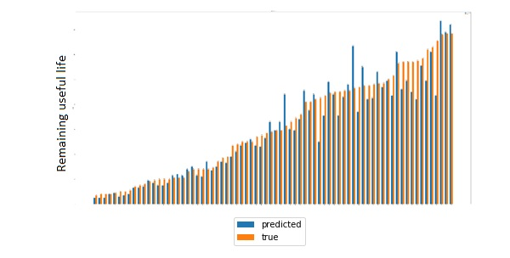
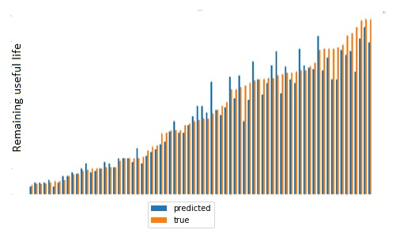
Piecewise and TCN
With Piecewise.
RMSE 10.23
Without Piecewise
RMSE 12.24
Notes:
In this experiment, we have tested how TCN results combine with the piecewise function. Piecewise point is set to 125, and TCN that is used is one combined with fusion. The important point here to say is how piecewise function affects the results. By the first image, we can see the graph off predicted and actual remaining useful life. On the left is one with piecewise function and on the right is without. The model with piecewise RUL performs worst where RUL is high, obviously because in training set it has never seen such data or if it was, that kind of data was rare. That lack of higher data compensates with high accuracy on the rest of the RUL estimation.

Slide 28
Piecewise and TCN
Notes:
Here we can see the absolute percentage error of one and the other. By this the graph we can see that model that has trained on piecewise function has constant error over time. In comparison, the other one has issues with smaller RULs, after that its percentage gets better.

Slide 29
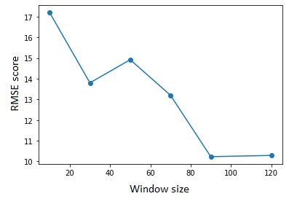
Parameter tuning; Window size
Two layer TCN model
Notes:
In this thesis, we have also tested various hyperparameters on our TCN model. The first test was to check how different window sizes affect the results. The sizes that we used were (10,30,50,70,90,120,137). By results, we can see how bigger windows size performs better the only problem with that was that you could not take the big window size because of our training and test data.

Slide 30
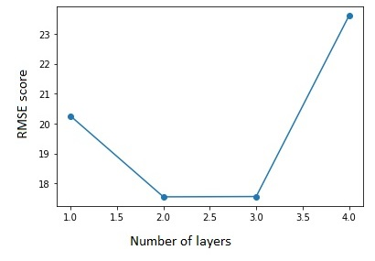
Parameter tuning; Number of layers
TCN Model
Notes:
Next, we have tested how the number of layers affects the results. We have tested with 1,2,3 and 4 layers. By this experiment, we can see that two layers are sufficient enough to do the test because of low computational power and lack of time we were not able to test more layers.

Slide 31
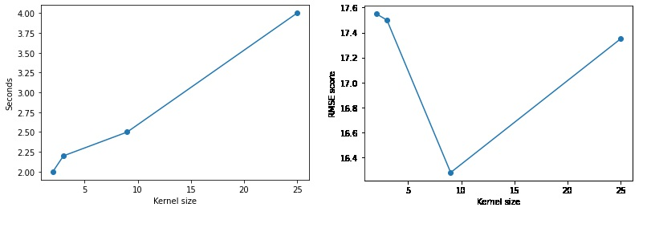
Parameter tuning; Kernel size
Two layer TCN model
Notes:
Our last experiment was with Kernel size. Sizes that we were tested were 2,3,9 and 25. we would use a more different variety of kernel size, but there are computational problems using to big kernel size. The image on the left represents speed depending on the kernel. We can see how increment in size drastically increases speed. The best result was achieved with kernel size 9, but also the computation was still long, so we have decided to take the one with the size of 2 because it is much much faster than the other ones.

Slide 32
Fusion
Combine 5 TCNs
10,30,50,70,90 layer sizes
Standard two layer TCN
Tests:
With one more TCN layer and dense layer
Only dense layer at the end
Without extra TCN - RMSE: 10.24
With extra TCN – RMSE: 10:51
Notes:
In this experiment, we have tried to implement the principle presented by Zhang et al. in his paper. They have used multiple LSTMs of different window sizes and combine it using Fusion. they have used layer sizes of 10,30,50,70,90. so in our experiments with that also. For this experiment, we have used our standard TCN version with two layers. First layer with 12 filters and a second layer with 6 filters with dilations and 20% drop out after each layer. In this experiment, we have also tested Fusion where the last layer is combined TCN and then dense layer, as well as only with the dense layer. The results show that using extra TCN layer does not improve results.

Slide 33
Comparison to the state-of-the-art
Name | RMSE score on FD001
LSTM-Fusion [2] | 11.18
MS-DCNN [3] | 11.44
Li-DAG [6] | 11.96
GRU-ED [5] | 12.45
DCNN [4] | 12.61
TCN-Fusion (Proposed method) | 10.23
TCN-Fusion Without piecewise | 12.24
Notes:
We have compared our methods to the state-of-the-art techniques in this field. The results are based on the same data set that we use. Furthermore, they all use the same score RMSE. As we can see by the results are TCN fusion outperforms the other methods. The first method is from which we have used the Fusion that one uses LSTM as a model. The second one uses multi-scale Deep convolutional neural networks. Third use Hybrid Model Based on Autoencoder and Bidirectional Long Short-Term Memory. GRU-ED uses Recurrent Neural Network, and DCNN uses Deep convolutional neural network. By this, we can see an immense potential of temporal convolutional neural networks in the field of predicting remaining useful life.

Slide 34
Conclusion
Research questions:
1. Is it possible to use temporal convolutional networks to outperform other known methods such as LSTM in the task of predicting remaining useful life?
2. How autoencoders affect results in the task of predicting remaining useful life when combining with the temporal convolutional network or with long-short term memory models?
3. How different parameters of temporal convolutional networks affect results in the task of predicting remaining useful life?
4. How the implementation of fusion, e.g. combining different models with different window sizes into one affect prediction of remaining useful life?
Notes:
We will start this section by answering our research questions mentioned in the Introduction section.
Is it possible to use temporal convolutional networks to outperform other known methods such as LSTM in the task of predicting remaining useful life?
By experimenting with temporal convolutional neural networks with fusion and without fusion, we have proven that they provide better results on C-MAPSS dataset then state-of-the-art methods.
How autoencoders affect results in the task of predicting remaining useful life when combining with the temporal convolutional network or with long-short term memory models?
By experimenting with autoencoder, we have concluded that in combination with TCN or LSTM, they do not provide any benefit in the task of predicting remaining useful life
How different parameters of temporal convolutional networks affect results in the task of predicting remaining useful life?
To answer this question, we have a separate results section.
How the implementation of fusion, e.g. combining different models with different window sizes into one affect prediction of remaining useful life?
Implementing fusion on the temporal convolutional network has improved results and gave us even better results than just TCN alone.

Slide 35
Future work
Use two separate TCNs for small and large.
RUL.Use big window size fill rest with zeros.
Test proposed method on other subsets FD002-3-4.
Hyperparameter optimization
Notes:
By doing this research, I have concluded that most problem comes from the data set. The problem with it that has significant variations when the remaining useful life is big and when the remaining useful life is small. As it is shown, data is mostly linear until exponentially changes near failure, while target to predict is linearly decreasing. Using one model to solve that type of problem without changes in target data seems to be impossible. For that reason, I have come to some ideas that could work on those problems. One is to use two separate TCNs one is for big RULs, and the other one is for small RULs. In the end, it will combine into one. The different approach is to use huge windows size and when it's not possible to fill rest with zeros or ones. Also, for this experiment, it is necessary that test this method on the other subsets as well as perform proper hyperparameter optimization. TCN has shown potential in solving this task. Still, there is much more left to do. With that, I conclude my presentation, do you have any questions?

Slide 36
References
van den Oord et al., “WaveNet: A Generative Model for Raw Audio,” pp. 1–15, 2016.
Y. Zhang, P. Hutchinson, N. A. J. Lieven, and J. Nunez-Yanez, “Remaining Useful Life Estimation Using Long Short-Term Memory Neural Networks and Deep Fusion,” IEEE Access, vol. 8, pp. 19033–19045, Jan. 2020, doi: 10.1109/access.2020.2966827.
X. Li, Q. Ding, and J. Q. Sun, “Remaining useful life estimation in prognostics using deep convolution neural networks,” Reliab. Eng. Syst. Saf., vol. 172, no. June 2017, pp. 1–11, 2018, doi: 10.1016/j.ress.2017.11.021.
[6] H. Li, W. Zhao, Y. Zhang, and E. Zio, “Remaining useful life prediction using multi-scale deep convolutional neural network,” Appl. Soft Comput. J., vol. 89, p. 106113, 2020, doi: 10.1016/j.asoc.2020.106113.
N. Gugulothu, V. Tv, P. Malhotra, L. Vig, P. Agarwal, and G. Shroo, “Predicting Remaining Useful Life using Time Series Embeddings based on Recurrent Neural Networks *-ing Useful Life using Time Series Embeddings based on Recurrent Neural Networks,” Canada (Tor)., vol. 10, 2017, doi: 10.1145/nnnnnnn.nnnnnnn.
J. Li, X. Li, and D. He, “A Directed Acyclic Graph Network Combined With CNN and LSTM for Remaining Useful Life Prediction,” IEEE Access, vol. 7, pp. 75464–75475, 2019, doi: 10.1109/ACCESS.2019.2919566.

Slide 37
Thank you!
Questions?

